Slide 1


CENTRAL BANK OF INDIA – MOBILE APPLICATION
PRESENTED BY
Thoushikamary F
Laksitha R

Slide 2


PROJECT DESCRIPTION
A Central Banking Application is a comprehensive, secure, and scalable software platform designed to assist central banks in managing their critical operations.
1. Convenient Recurring Bill Payments :
Automates payments for utilities like electricity, water, and phone bills, ensuring timely transactions and avoiding late fees
2. Seamless Loan Management:
Enables easy application, tracking, and repayment of loans, with clear visibility of schedules, EMI calculators, and personalized loan offers.
3. Enhanced Accessibility to Banking Services*
Provides 24/7 access to account balances, transaction histories, and fund transfers, making banking convenient and time-efficient.

Slide 3
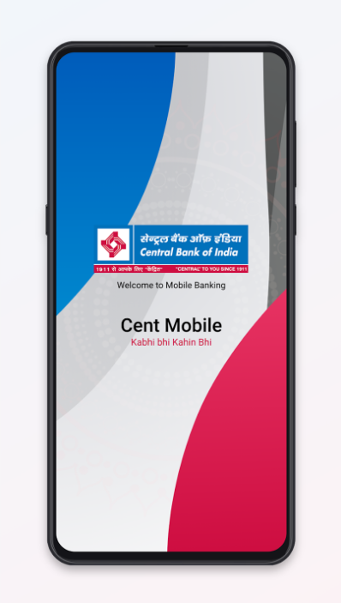
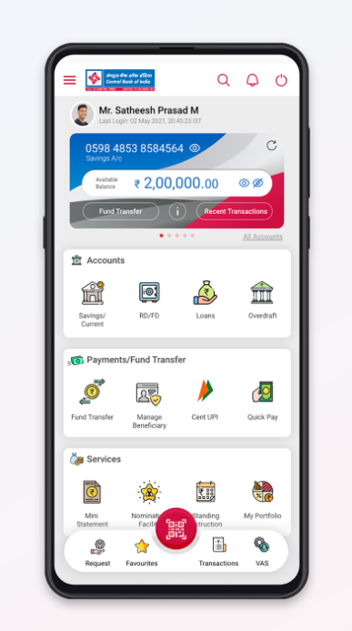
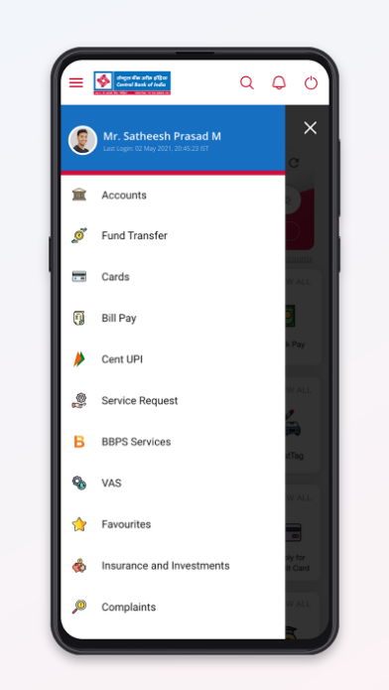
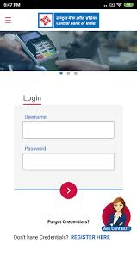
FUNCTIONALITY OF CBI APPLICATION

Slide 4
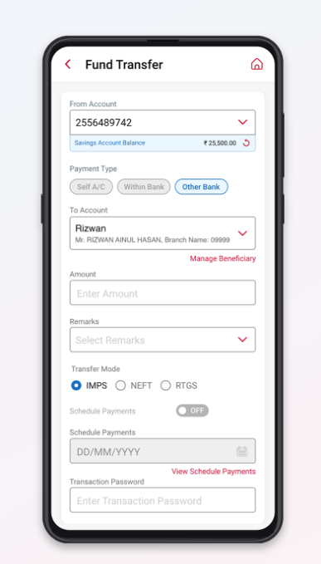
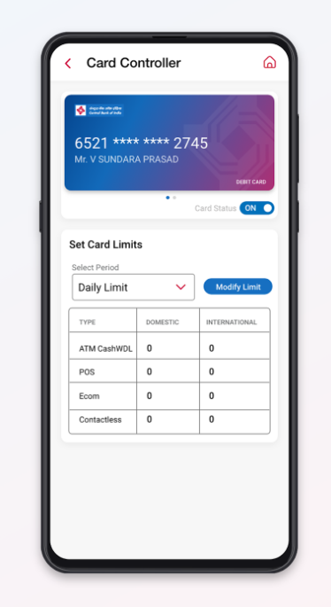
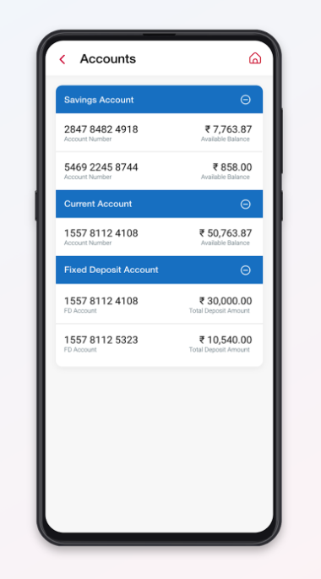

Slide 5

EPIC - 6
Register
Login
Fund Transfer
Customer Service Request
Loan Process
Manage or Schedule Bill

Slide 6
USER STORY - 13
EXAMPLES
User Account Creation
Identify Verification(KYC)
User Login with Credentials
Forget Password Recovery
Transfer Funds Between Own Accounts
Transfer Funds to External Accounts
Request New ATM/Credit/Debit Card
Block Lost or Stolen ATM/Credit/Debit Card
Apply for loan
Check Loan Eligibility
Track Loan Application Status
Schedule Recurring Bill Payments
View and Manage Upcoming Bills
As a new user, I want to register for the Central Banking application by providing my personal details(name,email,phone number) so that I can create an account and start accessing banking services
As a new user, I want to complete the KYC
process by uploading my identity documents(Aadhar,voter id) and verify my details
so that the account will be fully activated

Slide 7
ACCEPTANCE CRITERIA -13
EXAMPLES
1. Given the new user is on the Central Banking application registration page
when then user provide my personal details(name, email, phone number) and click register
then my account should be created successfully
User Account Creation
Identify Verification(KYC)
User Login with Credentials
Forget Password Recovery
Transfer Funds Between Own Accounts
Transfer Funds to External Accounts
Request New ATM/Credit/Debit Card
Block Lost or Stolen ATM/Credit/Debit Card
Apply for loan
Check Loan Eligibility
Track Loan Application Status
Schedule Recurring Bill Payments
View and Manage Upcoming Bills
2. Given the new user with a registered account is on the KYC page of the Central Banking application
When the user upload the identity documents (e.g.,aadhar,voter id etc)
Then the system should verify the uploaded documents and activate the account

Slide 8
TEST SCENARIO - 6
Check account creation functionality with identity verification.
Check login functionality and reset password
Check Fund transfer functionality between their own accounts and external bank accounts
Check the request card replacement (ATM, Credit, Debit) and report lost or stolen cards functionality
Check the Loan process functionality
Check the manage and scheduled bill payments functionality

Slide 9
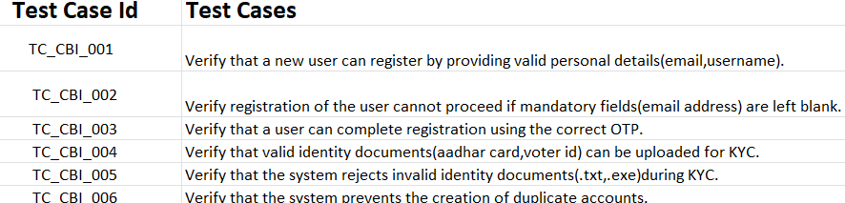
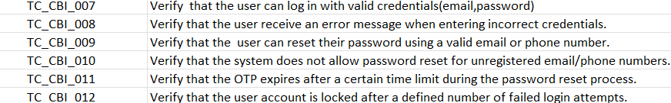
TEST CASES -36

Slide 10
DEFECT REPORT - 10
Defect in registration Page Mandatory field validation.
Defect in validating invalid file formats
Defect message not displayed for unregistered email/phone number
Defect in validating expired OTP during password reset.
Defect in exceeding the transaction limits.
Defect in cancelling Scheduling or pending Transfers
Defect in displaying Confirmation message for new card request
Defect in displaying Confirmation Message for Replacement Card Request
Defect in Determining eligibility for loan
Defect in validating loan page mandatory field

Slide 11
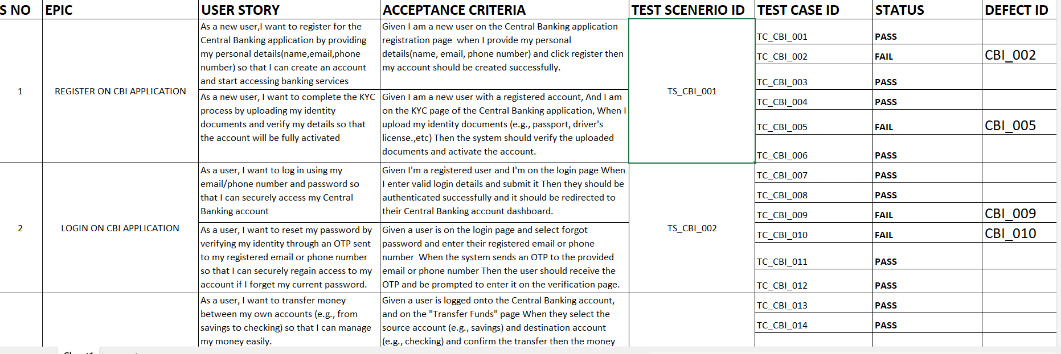
RTM - 13

Slide 12
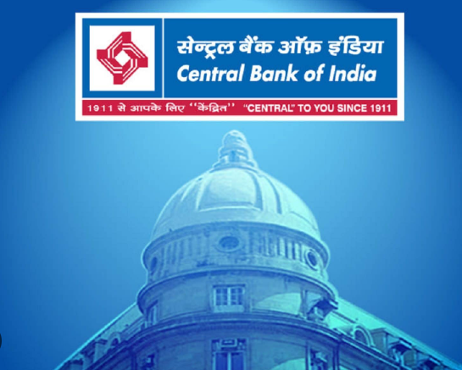
LEARNINGS
Familiarity with core banking operations, such as payments, settlements, regulatory compliance, risk management, and data security
Breaking down requirements into actionable and verifiable steps.
Writing clear, concise, and actionable defect descriptions.
Developing in-depth knowledge of the banking application’s functionalities and workflows.

Slide 13

SKILLS
Critical thinking
Analytical thinking
Effective communication
Collaboration
Documentation
Root cause analysis
System understanding
Prioritization

Slide 14

THANK YOU

